Slide 1
SDN Load Balancing
University Of Massachusetts, Lowell
Instructor : Prof Yan Luo
Presented By
Nithya
Rohan
Nidhi

Slide 2
Overview
Introduction to NFV
NFV
NFV vs SDN
Floodlight
Demo

Slide 3
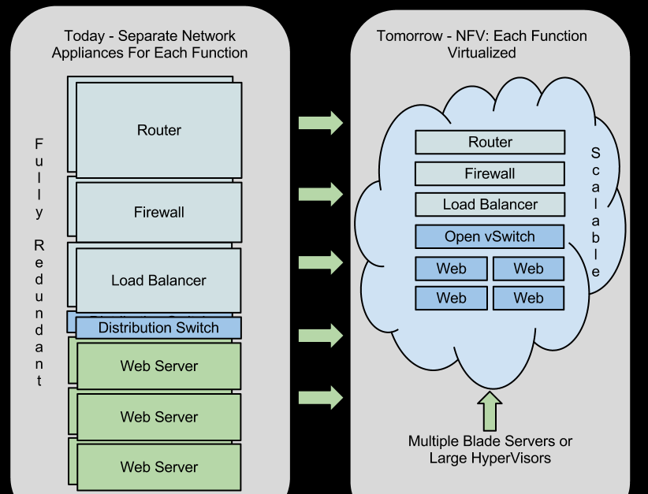
NFV
Definition
Goal : Decouple network functions from dedicated hardware
Notes:
The goal of NFV is to decouple network functions from dedicated hardware devices and allow network services that are now being carried out by routers, firewalls, load balancers and other dedicated hardware devices to be hosted on virtual machines (VMs). Once the network functions are under the control of a hypervisor, the services that once require dedicated hardware can be performed on standard x86 servers.

Slide 4
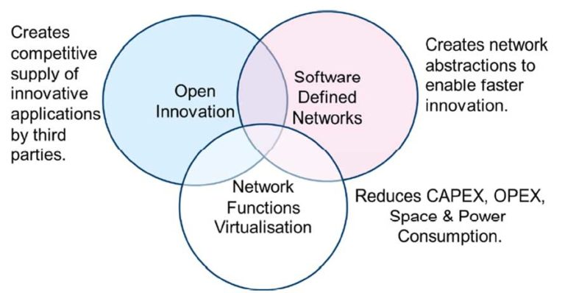
SDN vs NFV
Notes:
Network Functions Virtualization is highly complementary to Software Defined Networking (SDN), but not dependent on it (or vice-versa). Network Functions Virtualization can be implemented without a SDN being required, although the two concepts and solutions can be combined and potentially greater value accrued.
Network Functions Virtualisation goals can be achieved using non-SDN mechanisms, relying on the techniques currently in use in many datacentres. But approaches relying on the separation of the control and data forwarding planes as proposed by SDN can enhance performance, simplify compatibility with existing deployments, and facilitate operation and maintenance procedures. Network Functions Virtualization is able to support SDN by providing the infrastructure upon which the SDN software can be run. Furthermore, Network Functions Virtualization aligns closely with the SDN objectives to use commodity servers and switches.

Slide 5
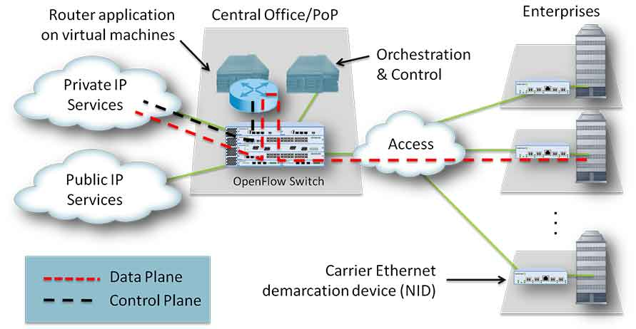
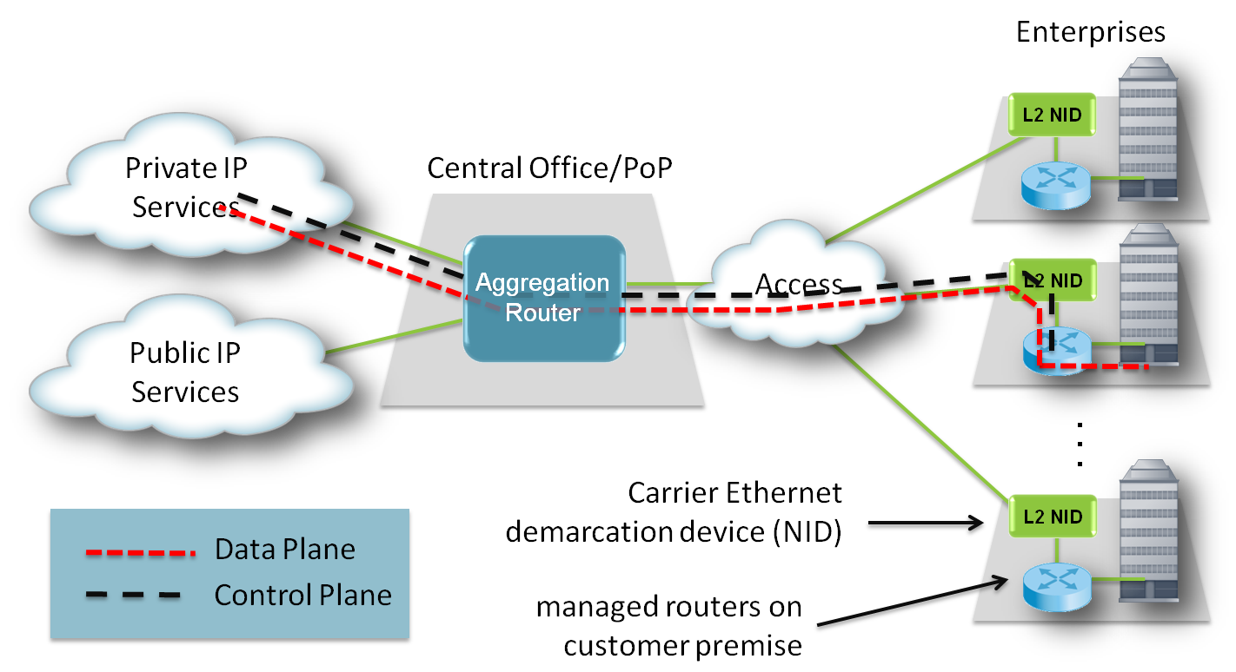
SDN and NFV ??
Figure 1
Figure 2
Notes:
Figure 1 shows how a managed router service is implemented today, using a router at the customer site.
NFV would be applied to this situation by virtualizing the router function, as shown in Figure 2. All that is left at the customer site is a Network Interface Device (NID) for providing a point of demarcation as well as for measuring performance.

Slide 6
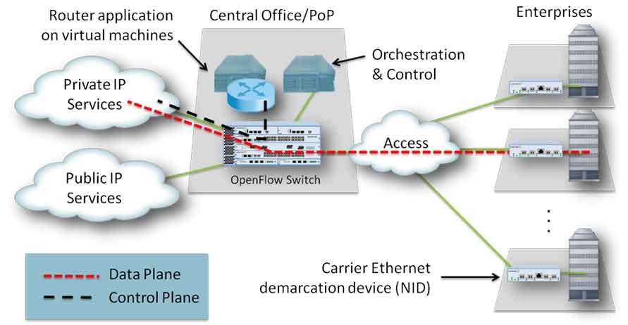
SDN And NFV
Notes:
Finally, SDN is introduced to separate the control and data, as shown in Figure 3. Now, the data packets are forwarded by an optimized data plane, while the routing (control plane) function is running in a virtual machine running in a rack mount server.
The combination of SDN and NFV shown in the figure provides an optimum solution:
An expensive and dedicated appliance is replaced by generic hardware and advanced software.
The software control plane is moved from an expensive location (in dedicated platform) to an optimized location (server in a data center or POP).
The control of the data plane has been abstracted and standardized, allowing for network and application evolution without the need for upgrades of network devices.

Slide 7
Summary
Category | SDN | NFV
Reason for Being | Separation of control and data, centralization of control and programmability of network | Relocation of network functions from dedicated appliances to generic servers
Target Location | Campus, data center / cloud | Service provider network
Target Devices | Commodity servers and switches | Commodity servers and switches
Initial Applications | Cloud orchestration and networking | Routers, firewalls, gateways, CDN, WAN accelerators, SLA assurance
New Protocols | OpenFlow | None yet
Formalization | Open Networking Forum (ONF) | ETSI NFV Working Group

Slide 8
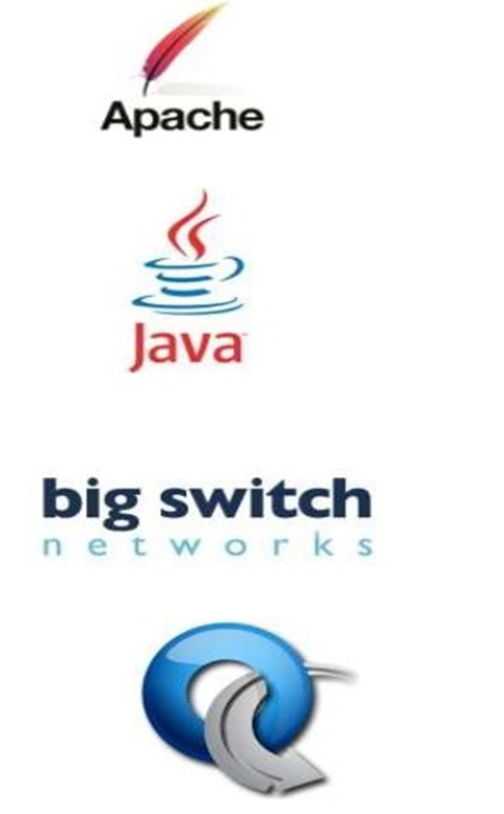
Floodlight overview
Developer friendly apache license
Easy to use
Enterprise Grade
Supports a broad range of switches
Notes:
Easy to use jdk

Slide 9
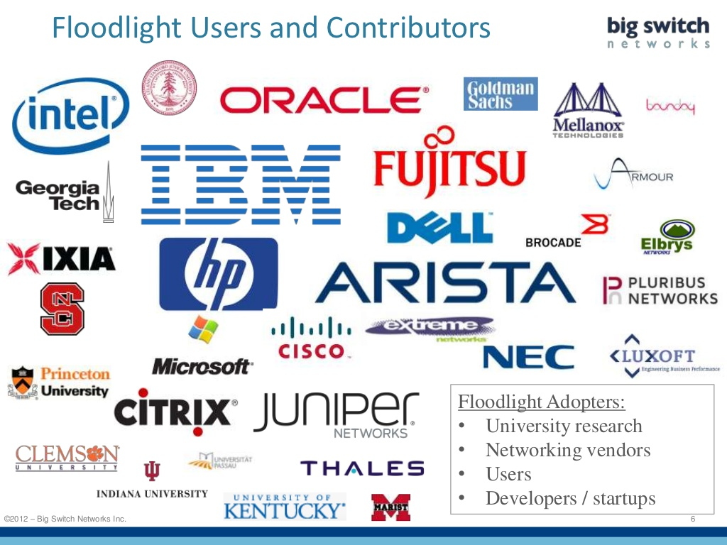

Slide 10
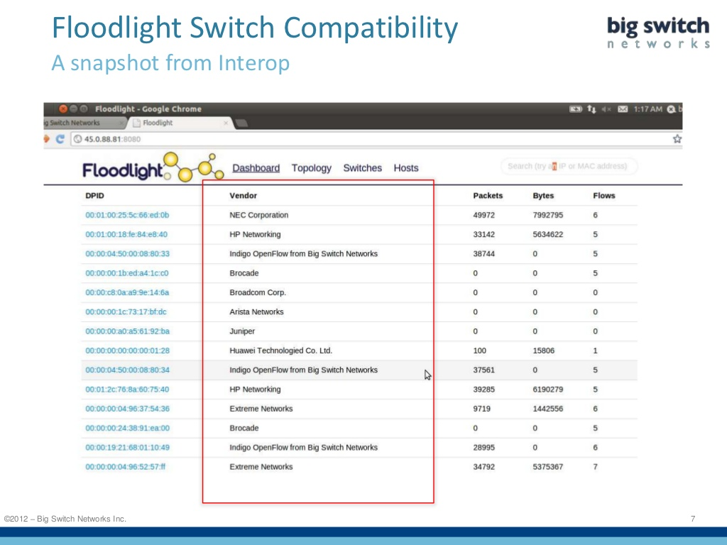

Slide 11
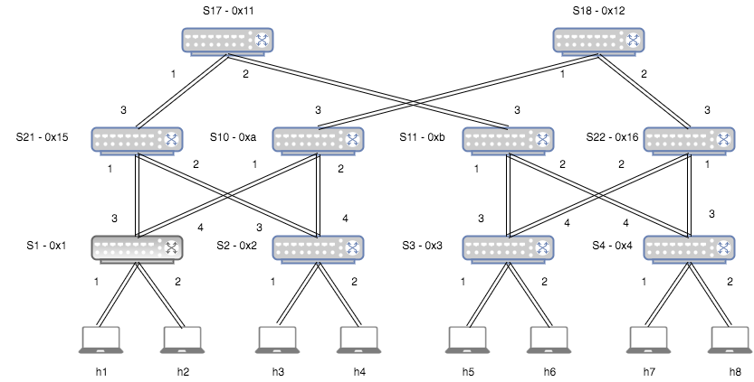
FAT TREE TOPOLOGY

Slide 12
DEMO

Slide 13
Thank You

